Slide 1
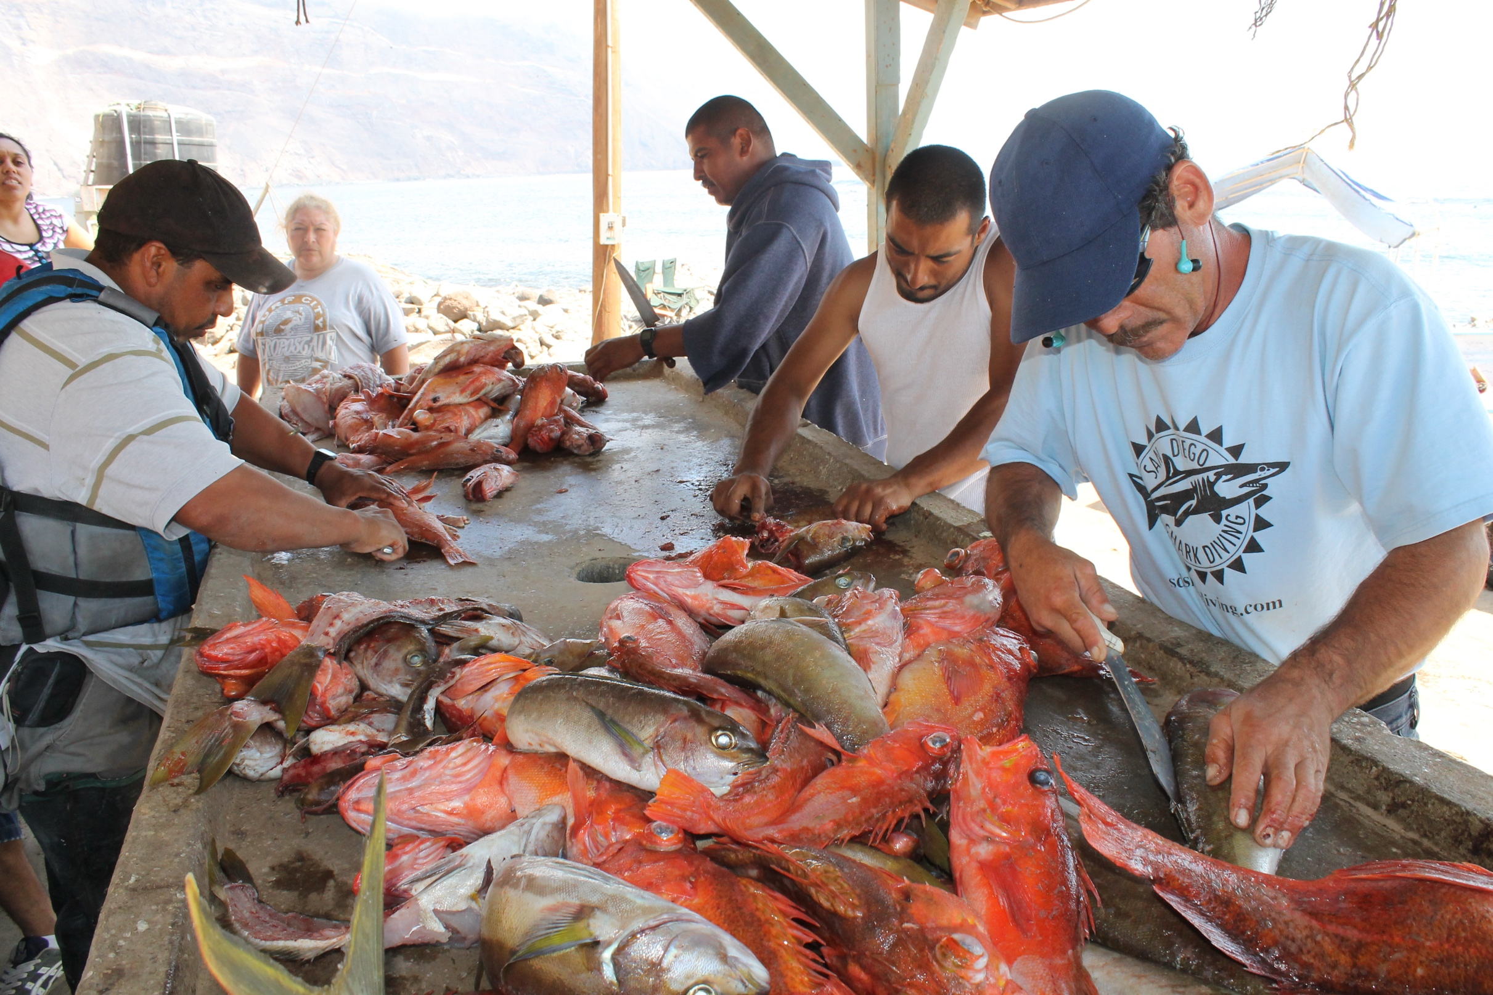
Framework to evaluate marine reserves in Mexico
Caio Faro, Jael Martinez, Juan Carlos Villasenor, Melaina Wright

Slide 2






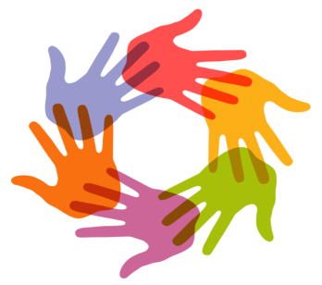
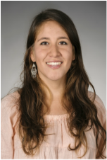
Introduction
Notes:
-4 of us, each have a role (ex. project manager) and each will divide work on the project, we are supported by Costello our faculty advisor and Sean our PhD advisor, and external advisors to provide us with additional support and expertise

Slide 3
Introduction
Notes:
-4 of us, each have a role (ex. project manager) and each will divide work on the project, we are supported by Costello our faculty advisor and Sean our PhD advisor, and external advisors to provide us with additional support and expertise

Slide 4
Academic Deliverables
Work plan
Website
www.turfeffect.org
Academic defense
Final report
Project brief
Project Poster
Public presentation

Slide 5
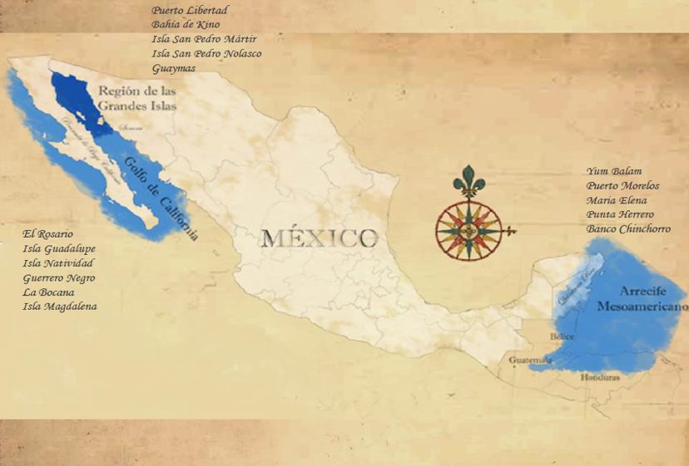
Project Scope
Figure 1: Regionalization of COBI’s working areas (in blue) and the fishing communities with whom they collaborate (labels). Source: COBI
Notes:
-After more than 15 years of collaboration with fishermen, COBI has been involved in the creation of 29 community-based no-take marine reserves (21,106 hectares) distributed among 13 different communities in the Gulf of California, Pacific coast of Baja Peninsula, and the Caribbean. They also collaborate with government agencies to design and monitor 10 Marine Protected Areas (617,703 hectares) that have no-take marine reserves (58,348 hectares) within their perimeters (i.e. core zones).
-These marine reserves can be no-take (fishing is off-limits), partially protected (extraction of specific species is not allowed), temporarily protected (only for a period of time) or a combination of temporal and partial protections.

Slide 6
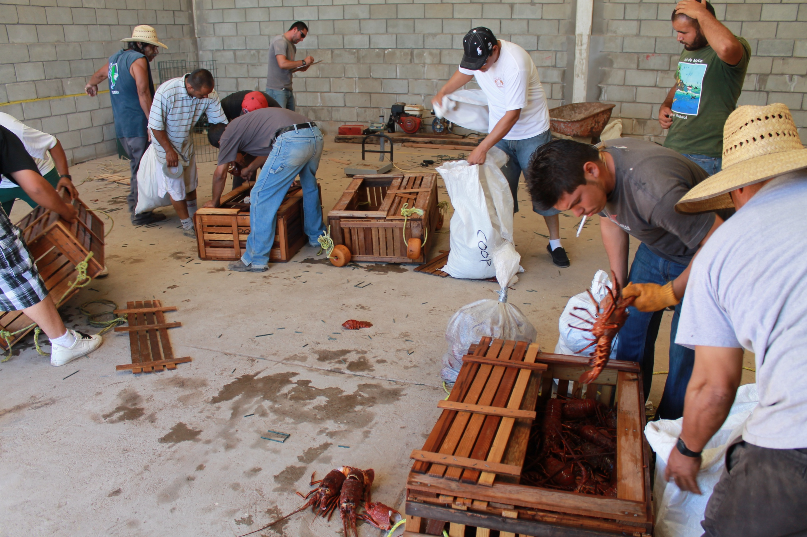
Have reserves met their objectives?
Notes:
-The extent to which these reserves have met their objectives is unclear. Each community has unique culture, natural resources, vulnerabilities, and governance structures. This hinders the use of conventional frameworks that evaluate the effectiveness of no-take marine reserves, and calls for the development of an appropriate tool capable of measuring effectiveness under the current scenario.

Slide 7
1. Determine a set of biophysical, socioeconomic and governance indicators that can be used to evaluate the effectiveness of no-take marine reserves in Mexico. 2. Use the selected indicators to propose a framework for evaluating the effectiveness of no-take marine reserves in Mexico. 3. Develop an English/Spanish guidebook with the selected indicators that walks the user through implementing our framework.
Objectives
Notes:
-The extent to which these reserves have met their objectives is unclear. Each community has unique culture, natural resources, vulnerabilities, and governance structures. This hinders the use of conventional frameworks that evaluate the effectiveness of no-take marine reserves, and calls for the development of an appropriate tool capable of measuring effectiveness under the current scenario.

Slide 8
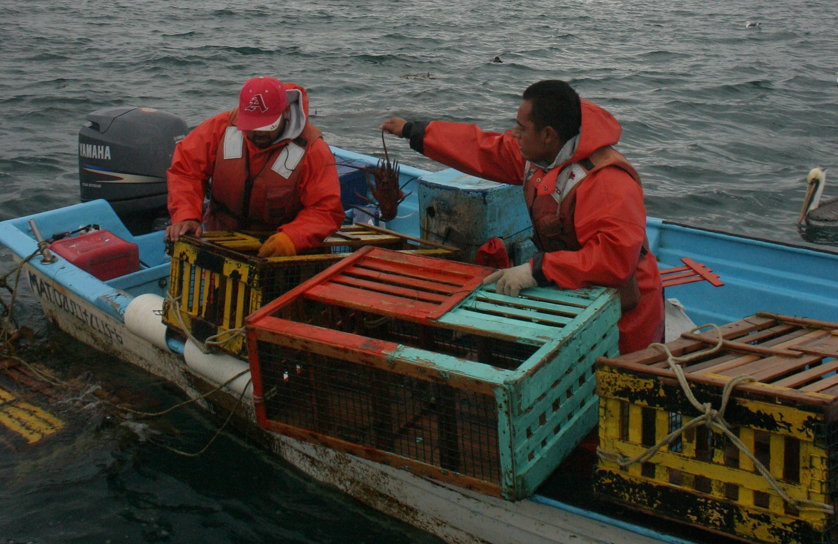
Selection of Indicators
Three categories:
Biophysical
Socioeconomic
Governance
Three types:
Outcome
Covariate
Explanatory

Slide 9
Analysis
Input:
Reserve and control
Post and pre-implementation
Analysis:
Difference-in-difference
Output:
DD estimate
P-value
Notes:
-Biophysical or landings (total or specific spp): Input of what you need ex. fish abundance and get post-pre treatment and control, DID by hand vs. linear regression, output: value of the DD estimate (positive or negative) trend and if do it by regression if this trend is significant
-We are still working on how we are going to analyze the governance indicators (since are explanatory)

Slide 10
Guidebook Sections
Introduction
Selection of indicators
Data Collection
Data Formatting
Analysis
Interpretation of results
Recommendations for improvement
Notes:
-Sections of guidebook: Introduction, Selection of Indicators (depend on objectives of reserve), Data collection, Data Formatting, Analysis: subsection for biophysical, governance and social; Interpretation of results: for each type of indicator; Recommendations for improvement

Slide 11
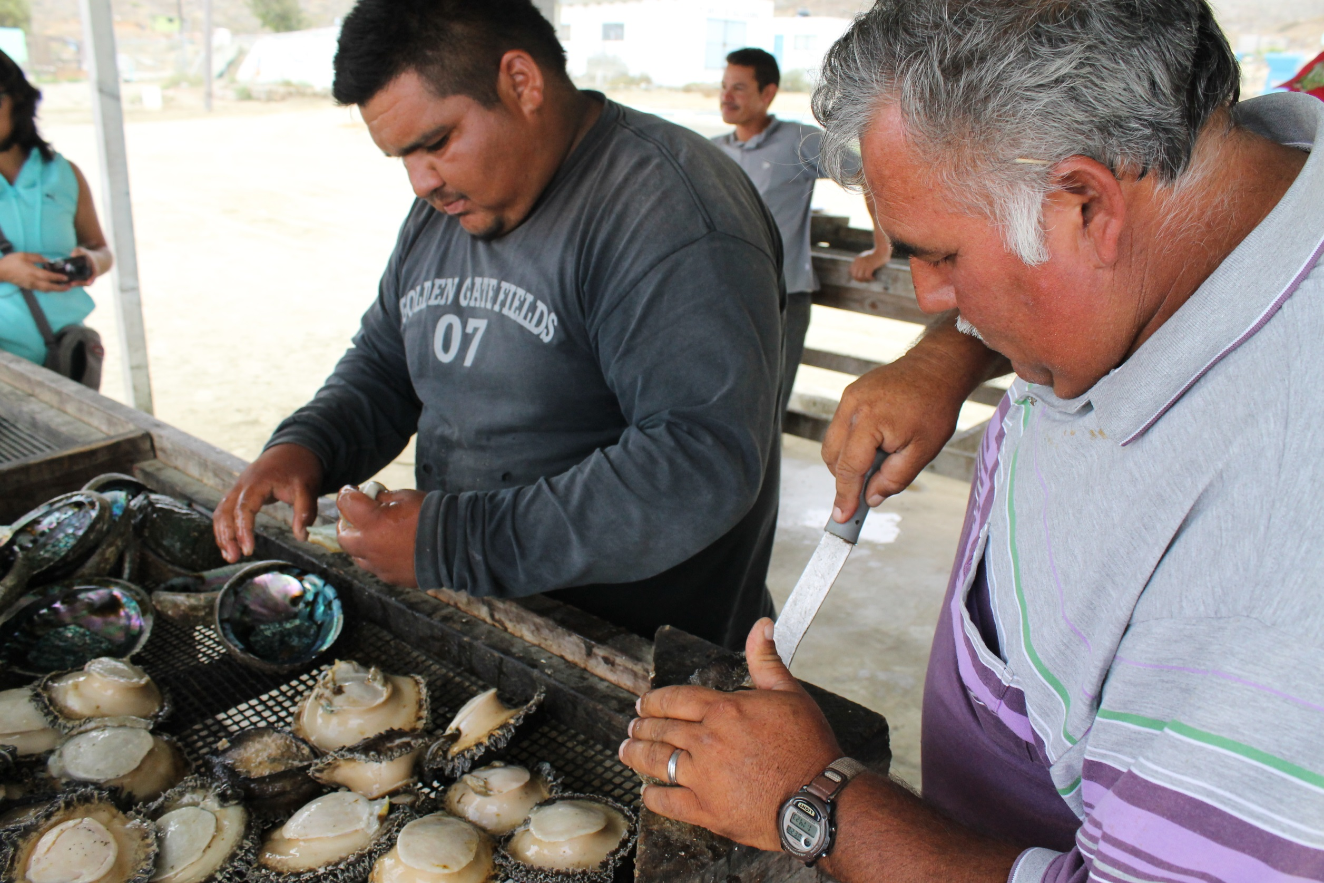
Shiny app Interface
Notes:
What is a Shiny app:

Slide 12
Biophysical Socio-Economic Governance
Indicator 1
Indicator 2
Indicator 3…
.
.
.
.
.
Indicator n
Indicator 1
Indicator 2
Indicator 3…
.
.
.
.
.
Indicator n
Indicator 1
Indicator 2
Indicator 3…
.
.
.
.
.
Indicator n
LEGEND OVERALL DOWNLOAD REPORT
Significant increase
Increase
No change
Decrease
Significant decrease
B SE
G
Notes:
Fore each indicator:
Colors are given based on the DID value and itr significance value. A positive and significant value would be green, a positive but not significant light green… and so on. On the back of the APP, these colors would be 1 for red and 5 for dark green, which will enable us to do some nice things for the next step:
For the “category-wise” indicator (the outer part of the circle):
Color of each third (yes, they are supposed to be thirds of a circle hehe) is given by a simple calculation where dark green would be that all indicators are green. Since we have numbers matching each color (red = 1, dark green =5), and we know that we used, say, 6 biophysical indicators, the maximum sum shoud be 30 (that’s 6 X 5). Therefore, if the scores for our 6 indicator swere {1,3,4,4,5,4}, that adds up to 21, from a maximum possible of 30. That maximum of 30 can be split into 5 ranges 1-6, 7-12, 13-18, 19-24, and 25-30, where they would be red, orange, yellow, light green and dark green, respectively. The good thing about this is that it could work for any number of indicators. If we had 20 indicators, maximum would be 100, and ranges would just be different (think of them as quantiles).
For the entire thing (thats the center of the circle):
Something similar happens either taking into account ALL the indicators of each category… Or perhaps a weighted average of the three category-wise indicators. The weight will be based on how much they value each of the categories (i.e. I like more fish than people, so I will weight biophysical higher than socio-economic)…

Slide 13
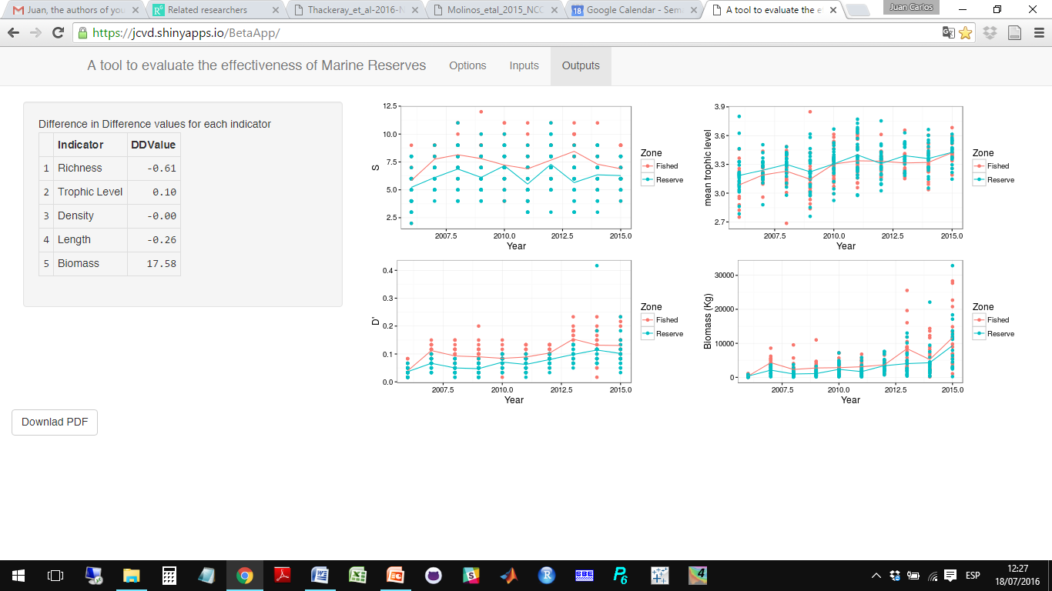
NICE, FANCY, TURFEFFECTY TITLE HERE
SocioEconomic indicators
Description of inputs
The analysis was performed for community XXXXX, using XXXX as year of implementation and XXXX as year of interest. The stated objective was XXXXXXXXXX,. The analysis used a total of XX indicators, divided as XX in Biophys, XX in SocioEco, and XX in Governance.
Read the results as……. I don’t know, some nice explanation about how to interpret the results.
Indicator | DID estimate | Graph
Total landings | + 3.56 (p = 0.23)
Managed species landings | - 2.1 (p = 0.01)
Blah blah blah | + 0.01 (p = .99)
Interpretation of results
Biophysical indicators
Indicator | DID estimate | Graph
Richness | + 3.56 (p = 0.23)
Density | - 2.1 (p = 0.01)
Biomass | + 0.01 (p = .99)
Governance indicatos
Indicator | Current | Suggestions
Type of organization | Open acess | Get a cooperative and a TURF
Enforcement of the reserve | Only government | Involve local communities
Blah blah blah…
Notes:
At the end of the document, a section with final recommendations or suggestions, which will be bases on out literature review, understanding of the social-ecological system, and any other analysis we perform with the data we have (including social and governance stuff).

Slide 14
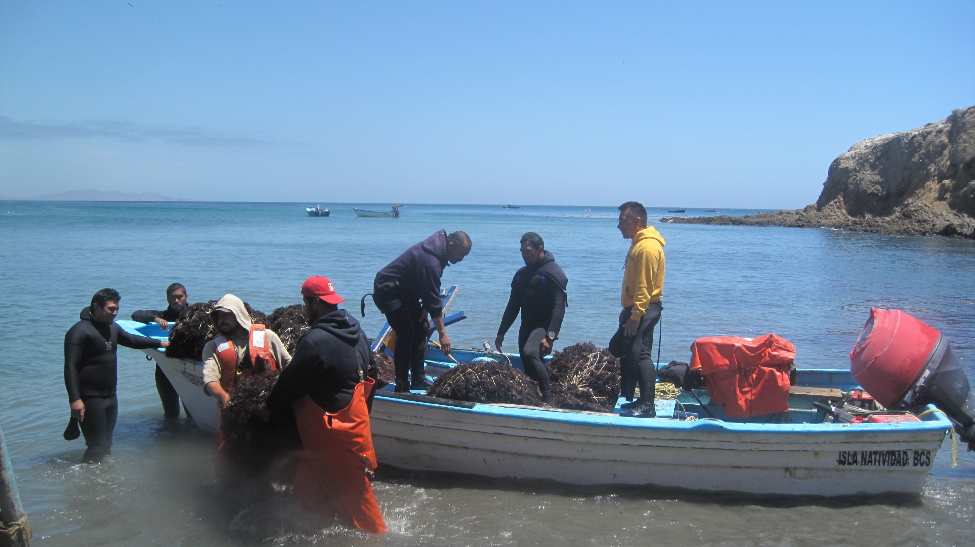
Next steps
Literature review
Data formatting
Survey
Run analyses together

Slide 15
Questions?

